Slide 1
Forming a Diverse and Cohesive Startup Team
C. Holly Wilbanks
Principal
The Wilbanks Consulting Group
Society of Petroleum Engineers
August 5, 2016

Slide 2
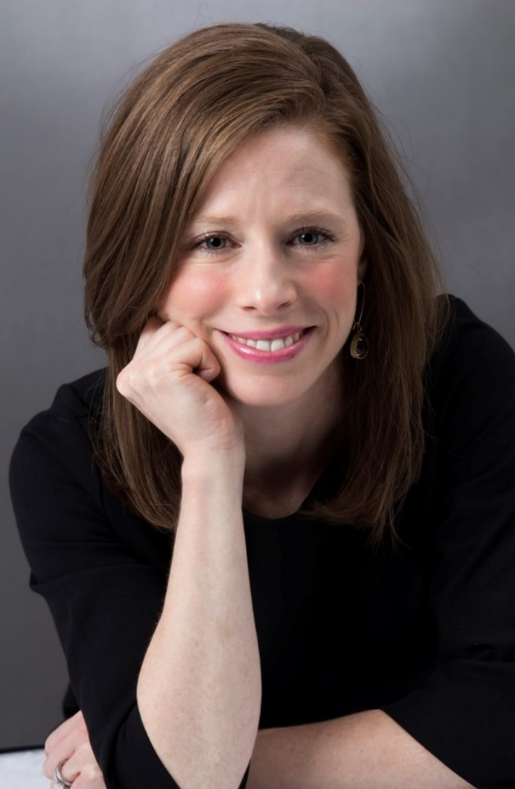
Introduction
C. Holly Wilbanks
Background
Certified MBTI® Practitioner
Industry innovator in recruitment, admissions, and career development
Prior to WCG, worked for Big Law, a London recruitment consultancy, HISD, and Baylor College of Medicine
Clients include Big Brothers Big Sisters, CareerEco Virtual Events, The Johns Hopkins University School of Medicine, Washington University in St. Louis, and individuals like you!

Slide 3
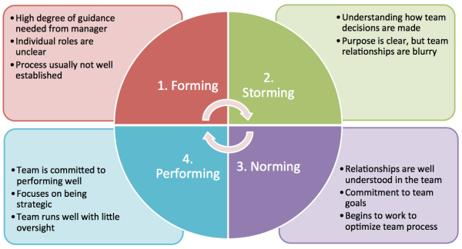
Stages of Team Development
http://blogs.atlassian.com/2013/07/how-atlassian-does-it-3-tips-for-remote-teamwork/

Slide 4
5 Traits of the Most Productive Startup Teams from Entrepreneur
Specialized
Uninterrupted
Flexible
Passionate
Trusting

Slide 5
Diverse Teams

Slide 6
What Do Diverse Teams Look Like?
Gender
Race
Ethnicity
Sexual Orientation
Disabilities
Generational
Geographic
Experience

Slide 7
Skills and Behaviors Represented
Good Listeners: ensuring that everyone is heard;
Open-Minded: making it safe to propose novel ideas;
Collaborative: giving team members decision-making authority;
Inclusive: sharing credit for success;
Good Communication: giving actionable feedback; and implementing feedback from the team.

Slide 8
Benefits of Diversity
Financial Results
According to McKinsey:
Gender diverse organizations are 15% more likely to outperform
Ethnically diverse companies are 35% more likely to outperform
Innovation
HBR Study:
Companies with 2-D diversity out-innovate and out-perform others

Slide 9
Benefits of Diversity
Retention
Various Sources
Feeling included and appreciated increases loyalty and feeling of belonging.
Increase Quality
NPR Study “Does Diversity On Research Team Improve Quality Of Science?”:
Papers written by multicultural teams were cited in other research more often than those written by homogenous groups.
Groups with members from geographic areas--perhaps three cities in the same country--also created better papers than those with members from the same place.

Slide 10
Diversity and inclusion is not an HR strategy; it is a business strategy.

Slide 11
Cohesive Teams

Slide 12
What Do They Look Like?
Mission Driven
Emotionally Intelligent
Diverse
Team-Oriented
Leverage Strengths
Communicate Effectively
Feedback (give and receive)
Fair
Celebrate/Recognize Success

Slide 13
Skills and Behaviors Represented?
Behaviors
Trust
Conflict
Commitment
Accountability
Results
Skills
Interpersonal (communication, respect, empathy)
Management (manage and be managed)
Leadership (lead and be led)

Slide 14
Benefits of Cohesive Teams
Loyalty
Table Group: “…the first priority of any organization is to build and maintain a cohesive leadership team, and the foundation of doing so is trust. Many organizations spend time and resources trying to build trust, but forget the importance of maintaining trust. One important aspect in maintaining trust is for team members to expect and exhibit loyalty to one another.”

Slide 15
Benefits of Cohesive Teams
Effective Communication
KSL-Training: “Communication within high performing teams centers on methods and frequency that work best for them. Inter and intra-departmental communication is managed well where vital information, proposal of new ideas and feedback are channeled across the organization.”
Shared Values
ATD: Without shared values, sustained high performance is impossible.

Slide 16
Benefits of Cohesive Teams
Increased Productivity
UCSF: While it takes much longer to establish consensus, this method ultimately provides better decisions and greater productivity because it secures every employee's commitment to all phases of the work.
Greater Innovation
HBR researchers “see cohesion as creating a psychologically safe environment that enables members to challenge each other and the status quo,” and is, therefore, a key to innovation.

Slide 17
ACTIVITY (6 min) In a group, share stories of how diversity and cohesion (or lack thereof) has positively or negatively affected a team dynamic you’ve experienced.

Slide 18
VOLUNTEER (4 min) Share your story.

Slide 19
CASE STUDY Fast Company Lever.

Slide 20
Best Practices for Identifying Team Members

Slide 21
Vision, Mission, Values
Vision
Mission
Values
A vision statement says what the organization wishes to be like in some years’ time.
The mission describes what business the organization is in (and what it isn’t) both now and projecting into the future.
Values describe the desired culture.

Slide 22
Creating an Effective Position Description: Managing Expectations
Role
Scope
Individual tasks involved
The methods used to complete the tasks
The purpose and responsibilities of the job
The relationship of the job to other jobs
Qualifications needed for the job

Slide 23
Best practices for position descriptions: Sections to include
Job title
Job objective or overall purpose statement
Summary of the general nature and level of the job
Description of the broad function and scope of the position
List of duties or tasks performed critical to success
Key functional and relational responsibilities in order of significance

Slide 24
Best practices for position descriptions: Sections to include
Description of the relationships and roles within the company, including supervisory positions, subordinating roles and other working relationships
Job specifications, standards, and requirements
Job location where the work will be performed
Equipment to be used in the performance of the job
Salary range

Slide 25
Best practices for position descriptions: Keep writing crisp and clear
Structure your sentences in classic verb/object and explanatory phrases. Since the occupant of the job is the subject of your sentence, it may be eliminated. For example, a sentence pertaining to the description of a receptionist position might read: "Greets office visitors and personnel in a friendly and sincere manner."
Always use the present tense of verbs.
If necessary, use explanatory phrases telling why, how, where, or how often to add meaning and clarity (e.g. "Collects all employee time sheets on a bi-weekly basis for payroll purposes.")

Slide 26
Best practices for position descriptions: Keep writing crisp and clear (continued)
Omit any unnecessary articles such as "a," "an," "the," or other words for an easy-to-understand description.
Use unbiased terminology. For example, use the he/she approach or construct sentences in such a way that gender pronouns are not required.
Avoid using adverbs or adjectives that are subject to interpretation such as "frequently," "some," "complex," "occasional," and "several."

Slide 27
Example: NeoSensory
Mechanical Engineer/Designer

Slide 28
CASE STUDIES Fast Company: Addepar and ZestFinance

Slide 29
Purpose of Interviewing
To get to know the candidate and see how he/she might fit in.
Identify:
What makes this candidate qualified for the position?
What does this candidate bring to this role/team/organization?
What are the gaps?
Do I/we like this person?

Slide 30
5 Most Common Interview Styles
Case
Behavioral
Situational
Panel
Presentation

Slide 31
How to Plan for an Effective Interview
Pick Interview Style(s)
Tell candidate in advance, if appropriate
Review candidate application
Highlight what appeals to you
Indicate if you have any questions
Review candidate LinkedIn profile
Prepare questions in advance

Slide 32
Synthesizing Candidate Information
Vision, Mission, Values
Skills
Strengths
____________
____________
____________
Gaps
____________
____________
____________

Slide 33
Synthesizing Candidate Information
Behaviors
Strengths
____________
____________
____________
Gaps
____________
____________
____________

Slide 34
Synthesizing Candidate Information
Candidate Goals
Align with company and position?
Unique Attributes
How will this candidate enhance the team?
____________
____________
____________
Other
_____________________________________________________________________________________________________________________

Slide 35
Synthesizing Candidate Information
Recommend Candidate for Hiring?
Yes
Would like to see other applicants before making a decision
No
Various Interviewers?
Create a scale
Include key skills and behaviors, and ask each interviewer to rank candidate

Slide 36
Hiring Assessments
Research based, data-driven analysis
Typically given just before an offer is extended
Measures areas you left out
Allows complete picture of strengths and skill gaps

Slide 37
Onboarding

Slide 38
What is Onboarding?
Robert Half Definition: the process to help just-hired employees acclimate to a new environment…. goes beyond mere practicality and acknowledges that what new employees learn in their first few weeks has long-term effects on their ability to tackle the challenges of today's faster-paced business environment

Slide 39
Onboarding Includes:
Meet and Greet
Orientation (Mission, Vision, Values)
Training
Mentoring
Scheduled Milestones

Slide 40
Team Integration
Combination of work focused and fun/relaxed activities
Lunches/Dinners/Happy Hours
Volunteering for an organization that aligns with the mission and values of your startup
No Limits New Initiative Brainstorm
Team-Building Workshop or Retreat

Slide 41
Team-Building Workshop
Myers-Briggs Type Indicator
Measures innate personality
Outlines how each person likes to work
Highlights strengths/blindspots
Creates opportunity upfront to establish a plan for how the team can best work together.

Slide 42
Work Scenario
Your team has secured an investor pitch in 6 weeks.
How do you go about planning for the pitch?

Slide 43
Know When to Outsource

Slide 44
Outsourcing, when possible
Startups have to do a lot of the initial work, but not everything
10,000 hour rule for expert status

Slide 45
Know When to Outsource
Mentors/Advisors
Startup Support Organizations
Products and Services

Slide 46
Questions?
WilbanksConsulting.com
Holly@WilbanksConsulting.com

