Slide 1
Hydraulic Fracturing Market
Q1 2024
SPE Gulf Coast North Side

Slide 2
Frac US Market by Quarter

Slide 3
Frac US Land Frac Stages
4%
5%
14%
28%
28%
Why does the number of frac stages pumped per quarter rise faster than drilling activity or frac crew count? This is a combination of three factors: Ever increasing lateral length, ever increasing frac stage density, and ever increasing pumping efficiency – more hours pumped per day, more simulfrac operations,… More frac work is done with less equipment.

Slide 4
Frac US Frac Stages Per Crew Per Quarter
4%
5%
14%
28%
28%
One key metric of the industry is the number of stages pumped per period of time per frac crew. Efficiencies in the frac industry allow stage count to exceed previous highs but with half the trucks. Pre-COVID frac crews pumped 300 stages per quarter average. Today, 600, which is double in just 4 years.

Slide 5
Frac North American Frac Crews
4%
5%
14%
28%
28%
Very few frac service firms report quarterly revenues resulting from the sale of hydraulic fracturing services. The chart above attempts to track and forecast quarterly active frac crews by company.

Slide 6
Hydraulic Fracturing US Frac Revenues ‘24
In a mature, slow growth market we expect additional consolidation to create 4-5 giant providers who each span the entire US.

Slide 7
Frac Annual Revenue Generation per Crew
In the North American frac market, the best frac service providers are now generating revenue of $90-100M per year for each of their active crews (or, as some call them, “fleets”). The chart above plots full year 2023 results. We assume that 5% discounts are implemented through 2023.

Slide 8
Hydraulic Fracturing Revenue per Stage
In 2018 the “per stage” frac revenues in the US were $50,000, down from $100,000 per stage in 2014. Pricing has settled around $33,000 per stage. The wild card in the mix is productivity of each frac spread: How many stages can one spread pump per day? For our analysis, we are assuming that productivity continues to rise. If it does not rise, then DUC count will build quickly.

Slide 9
Service Company Typical Customer Size
Spears sampled operators who drilled about 10,000 horizontal wells in the last year, identifying the service company pumping the frac job on each well. The chart on this slide indicates the AVERAGE NUMBER OF WELLS DRILLED IN 2023 for each frac service company’s typical customer. ProPetro’s customers, for example, drilled ~170 wells per year each while Gore’s drilled 37 each.

Slide 10
Service Company Addressed Market
Spears sampled operators who drilled 10,000 wells in 2023, identifying the service company fracturing each well. The chart on this slide indicates the TOTAL NUMBER OF WELLS DRILLED IN 2023 for each frac service company’s customers. HAL’s sampled customers drilled 4900 wells in 2023 while LBRT’s customers drilled 2800. None of these service companies won 100% of the work.

Slide 11
Service Company Competition
Here’s how to read this table: In LBRT’s case for example, on only 18% of the wells they work on will their customer ALSO be regularly using a different frac service provider. When Halliburton is the preferred frac service company for an E&P customer, 46% of the time that same customer will regularly use someone other than Halliburton on frac jobs in that basin.

Slide 12
Frac North American Frac Crews Q1 2024
4%
5%
14%
28%
28%
Very few frac service firms report quarterly revenues resulting from the sale of hydraulic fracturing services. The chart above attempts to track revenue-generating frac crews by company.

Slide 13
Hydraulic Fracturing Rigs:Frac Crew Ratio
Prior to 2016 it took 5 drilling rigs to keep a frac spread busy – most wells were vertical. By 2017, the ratio of rigs to frac spreads stabilized around 3.0. But in Q2 2020, rigs kept running but frac stopped cold (see the spike). Late 2020 and 2021, DUC completions drove frac work, so the ratio collapsed to 2.5. Post COVID the ratio has again stabilized at 3 rigs per active frac crew in North America..

Slide 14
Sand Supply Rail vs Implied In-Basin

Slide 15
Equipment Allison NoAm Off-Highway Sales
Most of Allison Transmissions’ oilfield sales are through their North American off-highway group and most of that group’s sales have been to the pressure pumping industry…and most notably, frac and cement. Allison’s frac sales trail an uptick in the frac market by about one year. We believe that Allison’s primary customers are Halliburton and PTEN/Nextier. Frac halted transmission spending in Q3 2023.

Slide 16
North America Total Frac Fleet
The North American frac fleet saw about 50 crews go idle during 2023 due to deteriorating economics for E&P companies. Despite the decline in activity, revenue generation per crew only fell 5%, making this one of the mildest downcycles ever in the frac industry.

Slide 17
Company Liberty Energy
Liberty Energy today consists of Liberty, SLB’s former OneStim division, and Weatherford’s US frac business. Charts above show Spears’ estimates of consolidated results. LBRT has an industry leading $24M/crew/quarter revenue generating rate. When LBRT wins a frac customer, that customer typically does not also employ a different frac service company.

Slide 18
Company ProFrac
ProFrac is a consolidator of the US frac industry. The charts above are pro forma all acquisitions – FTSI, US Well Service, Producers Service, REV….

Slide 19
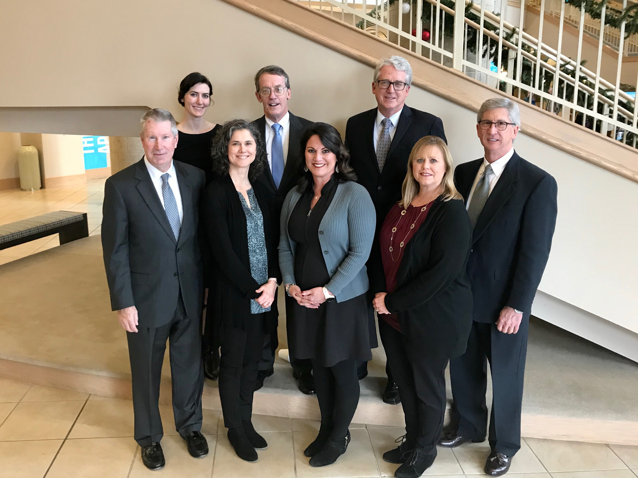
Authors
Spears & Associates has specialized in evaluating oilfield equipment and service markets and companies worldwide since 1965. The firm has completed 2400 custom oilfield market research projects around the world and will work for 225 clients in 2024.
The Firm is headquartered in Tulsa OK with colleagues in Fort Worth, Austin, Grand Junction, and Springfield, MO.
Contributors to this report include:
John Spears
President / Drilling & Production Outlook
Richard Spears
Vice President – Hydraulic Fracturing
Will Spears
Data Analyst
Missy Parker
Data Analyst
David Otte
Publisher, Oilfield Market Report
David Hutchison
Advisor to the Firm - Proppants
Katie Bewley
Director, Client Relations
www.spearsresearch.com / Tulsa, Oklahoma / 1.918.496.3434
Katie Bewley, Director, Client Relations / kbewley@spearsresearch.com

