Slide 1


Better Performance through Better Communication
Pelton Communications, LLC
Dr. David Pelton, DMA
SPE – GCS Guest Lecture Series
December 2, 2016
Houston, Texas

Slide 2

Communication
    By the end of this brief interactive lecture, you will know what communication is, what it does, how it works, and what to do to
    overcome distractions and disruptions that cause it to break
    down and be unproductive and ineffective.
Pelton Communications, LLCl
© 2016 Pelton Communications, LLC. All Rights Reserved.

Slide 3
Communication
What is it?
“The act or process of using words, sounds, signs, or
behaviors to express or exchange information or to
express…ideas, thoughts, feelings, etc., to someone else.”
- Merriam-Webster Dictionary
_____________________
_________________________
Pelton Communications, LLCl
© 2016 Pelton Communications, LLC. All Rights Reserved.

Slide 4

Communication
What does it take?
      Willingness to adapt and adjust
      Empathy and acceptance
      A positive attitude
      Respect and trust
”It is difficult to communicate where neither will trust.”
- Samuel Johnson
Pelton Communications, LLCl
© 2016 Pelton Communications, LLC. All Rights Reserved.

Slide 5
Communication
What does it do?
      Solves problems
      Gets results
      Builds strong, working, sustainable relationships
      Helps people learn, grow, succeed
      Improves productivity and profitability
Pelton Communications, LLCl
© 2016 Pelton Communications, LLC. All Rights Reserved.

Slide 6
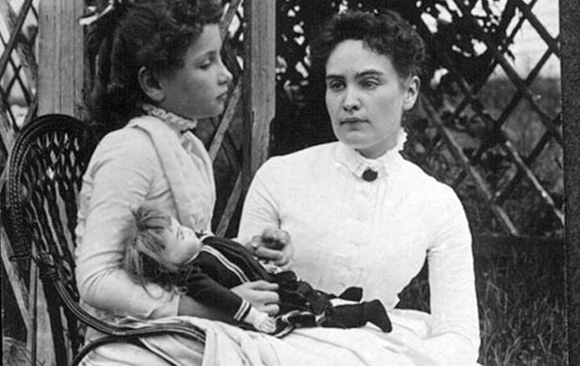
Communication
Pelton Communications, LLCl
© 2016 Pelton Communications, LLC. All Rights Reserved.

Slide 7
The Communication Cycle
Pelton Communications, LLC

Slide 8
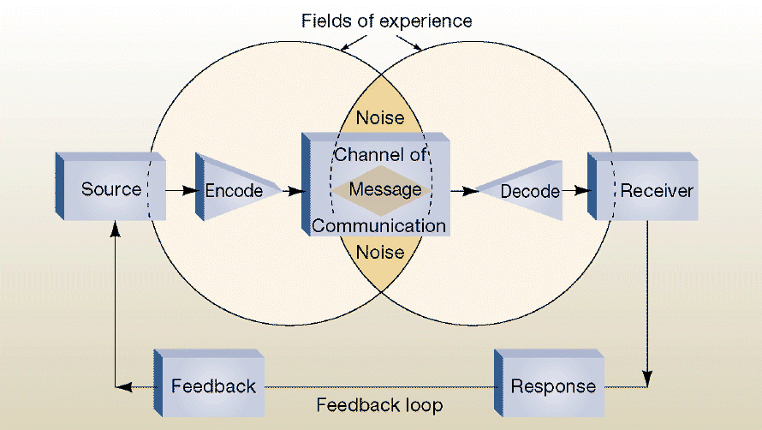
Communication: The Cycle
Environment
Pelton Communications, LLC
© 2016 Pelton Communications, LLC. All Rights Reserved.

Slide 9
Communication
Channels:
      Social media
      Emails / phone
      Face-to-face (f2f)
      Print (e.g. newspapers, magazines)
      Radio/television
      Audio/videos
Pelton Communications, LLCl
© 2016 Pelton Communications, LLC. All Rights Reserved.

Slide 10
Communication: The Cycle
Environment
Pelton Communications, LLC
© 2016 Pelton Communications, LLC. All Rights Reserved.

Slide 11
Communication
Noise
“A sound, gesture, word, or action that causes a person or persons responding or reacting to that sound, gesture, word, or action to be confused, made uncomfortable, or hurt in some way by that what they’ve seen, heard, or felt.”
Pelton Communications, LLC
© 2016 Pelton Communications, LLC. All Rights Reserved.

Slide 12
Communication
Noise
Physical
  Hands in and out of pockets
  Jiggling keys
  Clearing throat
  PowerPoint slides
  Appearance
  “Murphy”
Pelton Communications, LLC
© 2016 Pelton Communications, LLC. All Rights Reserved.

Slide 13
Communication
Noise
Physical
  Background music, conversations
  Sudden, unexpected interruptive sounds
Physiological
  Hunger, fatigue, pain
Pelton Communications, LLC
© 2016 Pelton Communications, LLC. All Rights Reserved.

Slide 14
Communication
Noise
Psychological
  Fears, worries, anxieties
  Stereotypes, assumptions, biases
Semantic
  “Clutterspeak” / improper grammar
  Offensive, inappropriate language
  Overly technical language
Pelton Communications, LLC
© 2016 Pelton Communications, LLC. All Rights Reserved.

Slide 15
Non-verbal Communication
Pelton Communications, LLC

Slide 16
Communication
\
Eye Contact
  Helps regulate flow of communication
  Signals interest in others
  Increases speaker’s credibility
  Monitors feedback
  Expresses emotions
Facial Expressions
  Express emotions and attitudes
  Provide feedback
  Act as primary sources of communication
“Non-verbal communication is an elaborate secret code that is written nowhere,
known by none, and understood by all.”
- Edward Sapir
Pelton Communications, LLC
© 2016 Pelton Communications, LLC. All Rights Reserved.

Slide 17
Communication
Gesture and Body Language
- Movement and Posture -
  Communicate messages through walking,
  talking, standing and sitting
  Animate communication and enhance
  comprehension
Proximity
  Follow cultural mores to keep a respectful
  distance when interacting with others
  Be aware of signs that show discomfort:
  - Rocking / Tapping / Gaze aversion
Pelton Communications, LLC
© 2016 Pelton Communications, LLC. All Rights Reserved.

Slide 18
Communication
Paralanguage
  Non-verbal speech (vocal variation of sound)
  used to communicate
Appearance
  Conclusions drawn from grooming, carriage, manners
  Shows self-confidence and understanding of
  – and respect for – the audience
Pelton Communications, LLC
© 2016 Pelton Communications, LLC. All Rights Reserved.

Slide 19
Communication
Touch
  Indicates power and dominance / consolation
  and support
  Men and women through touch communicate
  in different ways
  Different cultures through touch communicate
  in different ways
You cannot not communicate
Pelton Communications, LLC
© 2016 Pelton Communications, LLC. All Rights Reserved.

Slide 20
“What We’ve Got Here Is Failure To Communicate”
Cool Hand Luke, 1967
Pelton Communications, LLC

Slide 21
Communication
Barriers:
      The use of complicated, unfamiliar, overly technical language
      The inability to express emotions and to refrain from sharing emotions considered unacceptable or “off limits”
      Letting emotions “get in the way”
      Apathy, laziness, disinterest, lack of motivation and desire to communicate
      Differences in perceptions and points-of-view
Pelton Communications, LLCl
© 2016 Pelton Communications, LLC. All Rights Reserved.

Slide 22
Communication
Barriers:
      Physical disabilities in hearing and/or speaking
      The inability to see non-verbal cues
      Differences in language and inability to understand unfamiliar accents
      Expectations and prejudices that may lead to false assumptions and stereotyping
      Differences in culture
Pelton Communications, LLCl
© 2016 Pelton Communications, LLC. All Rights Reserved.

Slide 23
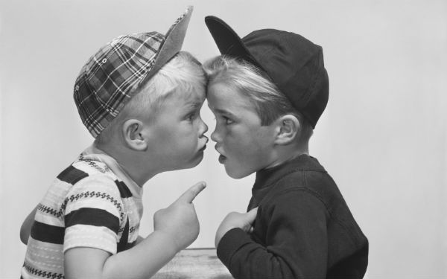
Communication
Pelton Communications, LLCl
© 2016 Pelton Communications, LLC. All Rights Reserved.

Slide 24
?
david.pelton@petroskills.com
Pelton Communications, LLC

Slide 25
Principles and Tenets
Pelton Communications, LLC

Slide 26
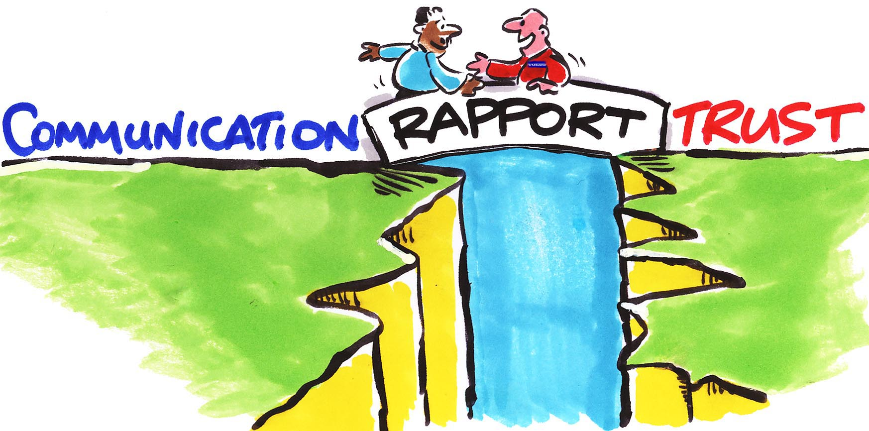
Communication
3 Guiding Principles for achieving Excellence
ALWAYS
respect the
person you’re
communicating
with
ALWAYS be in command of yourself and your emotions
ALWAYS listen (accurately), observe (carefully) and question (wisely)
- ask the right question in the right way at the right time -
Pelton Communications, LLCl
© 2016 Pelton Communications, LLC. All Rights Reserved.

Slide 27
Communication
Tenets:
  Think about what you’re going to say or do before saying or doing it / Know why you’re communicating / Know something about the person or persons you’re communicating with / Be aware of cultural customs and mores
  Think about how you’re going to say or do what you want to say
  or do / Choose the proper channel (e.g. f2f, social media, phone)
  Think about how people are going to react and respond to what you say or do / Be ready for feedback
Pelton Communications, LLCl
© 2016 Pelton Communications, LLC. All Rights Reserved.

Slide 28
Communication
Tenets:
  Eliminate distractions and disruptions / Use language that is appropriate, understandable and inoffensive
  When communicating f2f, pay attention to what others are saying or doing / Make eye contact / Show interest with body language / Use a voice that’s pleasant and easy to listen to / Don’t send mixed messages – don’t have your voice say one thing and your body say another
Pelton Communications, LLCl
© 2016 Pelton Communications, LLC. All Rights Reserved.

Slide 29
“The single biggest problem in communication
is the illusion that it has taken place.”
- George Bernard Shaw
Pelton Communications, LLC

Slide 30
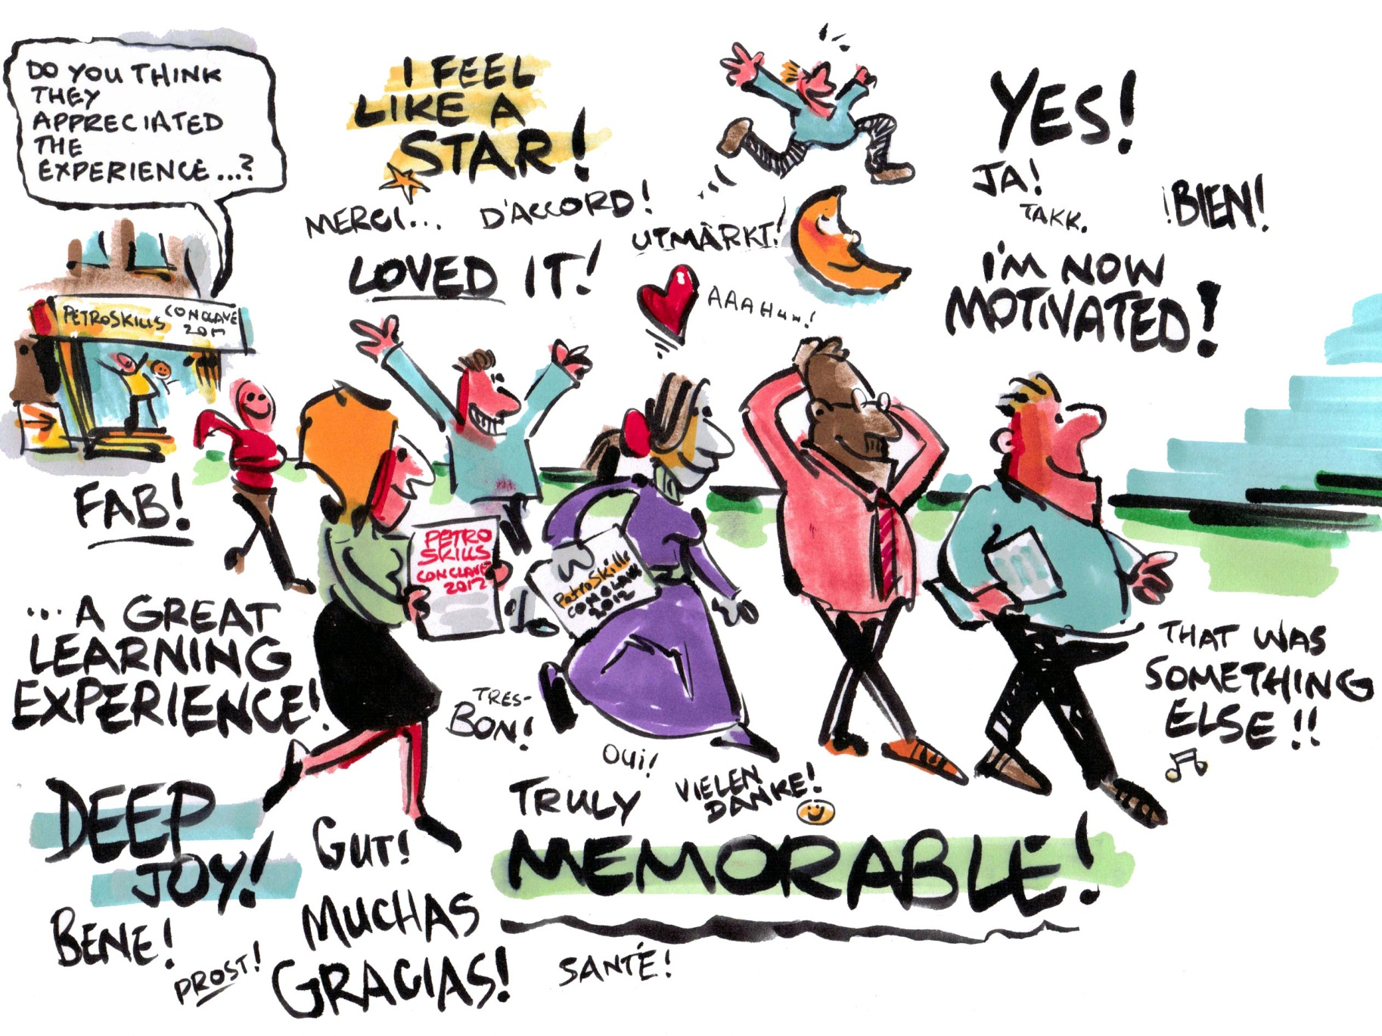
Communication
Pelton Communications, LLCl
© 2016 Pelton Communications, LLC. All Rights Reserved.

